Slide 1
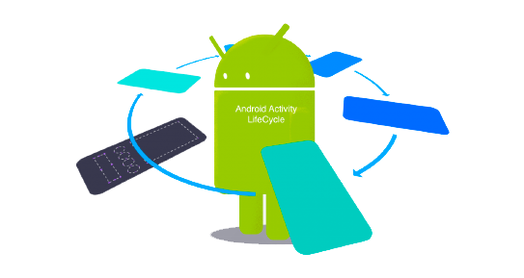
Activities
2023-24

Slide 2
Android apps
An app is made of one or more components that are declared in the manifest file
Different types of components
Activities
Services
Broadcast receivers
Content providers
Components are automatically created by the operating system in response to requests containing an intent

Slide 3
android.app.Activity
Base class that provides a GUI with which users can interact in order to do something
Applications extend this class to implement specific functionalities
The name of the derived class is specified in the manifest-file
The operating system creates the activity and manages its life cycle invoking some specific methods
onCreate(…), onStart(), onResume(), onPause(), onStop(), onDestroy()

Slide 4
Role and responsibilities
An activity manages user interaction
Acquires the required resources (requires the use of sensors, loads contents, …)
Builds and configures a graphical user interface
Reacts to the events triggered by user interactions with widgets to implement the desired behavior
Manages the notifications regarding its own life cycle, storing data collected by the interface and releasing resources when the operating system asks so

Slide 5





Activity (1)
Creates and configures
Activity
Name
…
Life cycle
notifications
User
interactions
Address
…
Acquires and releases
ok
GUI

Slide 6
Activity (2)
An activity typically shows a single user interface that allows only some types of user interaction
An application may contain several activities
Each one typically supports a single task (e.g., create a new message, read a received message, manage the received messages, …)
One of them is marked in the manifest file to be the first to be shown to the user, when the application is started by the launcher
An activity may start another activity, by creating an Intent object
The called activity may be either part of the same application or may belong to a different one

Slide 7
Activity stack
For each task started in the “home” screen of the device, the operating system builds an activity stack
Initialized with the default activity of the corresponding task
During its life cycle, an activity may request the system to start a new activity
The latter will be created and inserted at the top of the stack, and will become visible and interactive
The previous activity is shifted one position and will remain in background until the new one is alive
If the new activity explicitly terminates or if the user presses the Back button, the previous activity reaches the top of the stack and becomes visible and interactive again

Slide 8
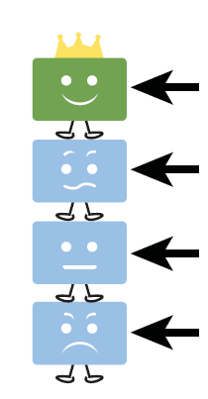
Activity stack
First activity: the user can see and interact with it
Second activity: it is visualized if the user uses the back button or if the first activity terminates
Users can not see and interact with these activities until the preceding ones are alive
Last activity: if the others activities require too many resources, this one can be terminated

Slide 9
Activity life cycle
The Android operating system allows the execution of several tasks at the same time
Provided that there is enough memory space and energy charge
Each task consists of one or more components (activities, services, …) and of all the related classes and resources
An activity can be interrupted and paused when given events are triggered
For example, if a phone call is received

Slide 10
Activity life cycle
Android sends different notifications to track the status of an application and its evolution according to user interaction, system-level events, and resource availability
The programmer has to react to these notifications, performing the actions that are needed to guarantee the correct management of all the application resources
Releasing and re-acquiring them whenever it is necessary
In addition to obvious events, the management of the life cycle also includes less obvious situations, often source of confusion
When you rotate a device, the current activity is destroyed and recreated with new parameters
The same happens if you set a different language on the control panel

Slide 11
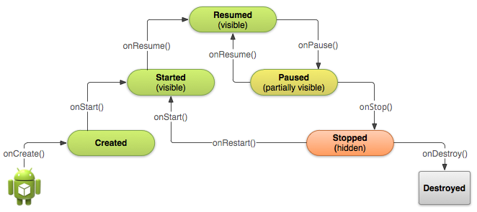
Activity life cycle

Slide 12
Activity life cycle and visibility
The operating system notifications indicate the different phases of the application
onCreate(…) / onDestroy() – The activity exists but is not visible to the user
onStart() / onStop() – The activity is visible, but the user can not interact directly with it (another partially obscuring window is on top of it)
onResume() / onPause() – The activity is in the foreground and the user can interact with it

Slide 13
Managing the activity life cycle
If overridden, the methods related to the life cycle notifications should call the implementation of the superclass
Failing that, the system will throw an exception and exit the application
class MainActivity : AppCompatActivity() {
override fun onCreate(savedInstanceState: Bundle?) {
super.onCreate(savedInstanceState)
// other actions
}
}

Slide 14
onCreate()
The method onCreate(b: Bundle?) is called in two different scenarios
When the activity is run for the first time
The Bundle parameter is null
When the activity is launched again after being terminated (due to lack of resources or for other reasons)
The Bundle parameter contains status information
In this method, it is appropriate to perform most resource allocation and data initializations
Such as those related to the management of the active screen and the data link

Slide 15
Example
class ExampleActivity: AppCompatActivity() {
override fun onCreate(b: Bundle?) {
super.onCreate(b)
//Programmatically create and initialize a view
val tv = TextView(this)
tv.text = "Hello, Android!"
tv.gravity = Gravity.CENTER
//show the view content
setContentView(tv)
}
}

Slide 16
onStart()
Method called when the application becomes visible to the user
If the activity has been previously visible, this method is preceded by the call to the onRestart() one
In most common cases, it is not necessary to redefine this method

Slide 17
onResume()
The onResume() method is called when the activity reaches the top of the activity stack and becomes interactive
In this method, it is possible to start animations, videos, sounds, ... , and to acquire temporary resources (like sensors and cameras)

Slide 18
onPause()
The onPause() method is called when the activity has to be moved to the second position of the activity stack
Here, sounds, videos and animations are usually stopped
In this method it is appropriate to release all resources that are not needed while the application is in the background
If the application handles persistent information (databases, files, preferences, ...), here data is usually committed
If the activity has registered any listener of system events, sensors, services, ..., here they are unregistered
Warning: the next activity will not start until the onPause() method is running
Thus, it is necessary to limit the duration of the operations carried out here

Slide 19
onStop()
Called when the application is no longer visible to the user
The next possible notification can be onRestart(), onDestroy(), or nothing at all depending on user's interactions and system's resource management needs

Slide 20
onDestroy()
The activity has been terminated and will be removed from memory
The invocation may be the result of an explicit request of the application
Having invoked the finish(...) method...
Or of the need of the system to free resources
The isFinishing() method allows us to distinguish between the two situations

Slide 21
Preparing the GUI
In the onCreate(…) method, you have to prepare a GUI and make it visible
It is in charge of presenting content to the user and allow interaction
Two different approaches are available: creating a set of View objects or invoking a set of @Composable functions
In any case, the GUI is conceptually modelled as a tree of widgets
The hierarchical structure of the tree reflects the usage of space inside the display
If a widget is a "child of" another widget, it is usually contained in the space of the parent one

Slide 22

The visual tree
Container
Image
Panorama
Text
send
Button

Slide 23
Modelling the GUI as a set of objects
Android has been offering, since its inception, a set of classes aimed at modelling the widgets of the GUI
These classes are part of an inheritance hierarchy rooted at the android.view.View class
The hierarchy is built according to the composite pattern
Its aim is to organize objects into tree structures to represent part-whole hierarchies
Class android.view.View represents any widget that may be displayed onto the screen
Its subclass android.view.ViewGroup represents the subset of View that may act as a visual container, i.e., have children

Slide 24
The composite pattern
0..*
child
View
+ onDraw(…)
+ onMeasure(…)
…
ViewGroup
ImageView
TextView
1
parent
+ addView(…)
+ removeView(…)
+ getChildAt(…)
Button
LinearLayout
RelativeLayout

Slide 25
Create the View display hierarchy
While it is possible to manually instantiate the single widgets and configure their parameters, this is not convenient except in trivial cases
The view tree is most often defined in a layout XML file, which is later transformed in a view tree by an inflater
Activity method setContentView(...) is used to instantiate such a tree
In the first approach, the various visual components are directly instantiated
And they are connect to each other so as to form the desired hierarchy
The content are configured and event handlers are registered

Slide 26
Programmatic view creation
override fun onCreate(savedInstanceState: Bundle?) {
super.onCreate(savedInstanceState)
// create and configure the main container
val ll = LinearLayout(this)
ll.orientation = LinearLayout.VERTICAL
// create and configure the parts it contains
val iv = ImageView(this)
iv.setImageResource(R.mipmap.ic_launcher)
val tv = TextView(this)
tv.text = "Panorama"
tv.gravity = Gravity.CENTER_HORIZONTAL
val b = Button(this)
b.text = "Send"
ll.addView(iv)
ll.addView(tv)
ll.addView(b)
// show the hierarchy
setContentView(ll)
}

Slide 27
Programmatic view creation
Pros
Flexibility: You can insert/configure each component on the basis of the data processed by the application
Control: everything that is created has been done explicitly by the programmer
Cons
Maintenance is difficult
Poor support for internationalization

Slide 28
Create a view via XML
The XML files in the folder "res/layout" describe the visual hierarchy
The build environment automatically associates, to each such file, an integer constant in the class R.layout
The name of the constant is the name of the file, the value is automatically selected in order to make it unique
An overloaded version of the setContentView(…) method accepts an integer as a parameter
It is used to identify and load the XML file
For each element described in the file, the corresponding Kotlin object is created and initialized with all its attributes
override fun onCreate(b: Bundle?) {
super.onCreate(b)
setContentView(R.layout.activity_main)
}

Slide 29
Create a view via XML
res/layout/main.xml
<?xml version="1.0" encoding="utf-8"?>
<LinearLayout xmlns:android=
"http://schemas.android.com/apk/res/android"
android:orientation="vertical"
android:layout_width="match_parent"
android:layout_height="match_parent">
<ImageView
android:layout_width="match_parent"
android:layout_height="wrap_content"
android:src="@drawable/panorama"/>
<TextView
android:layout_width="match_parent"
android:layout_height="wrap_content"
android:text="@string/picture_text"/>
<Button android:id="@+id/button1"
android:text="@string/button_label"
android:layout_width="match_parent"
android:layout_height="wrap_content"/>
</LinearLayout>

Slide 30
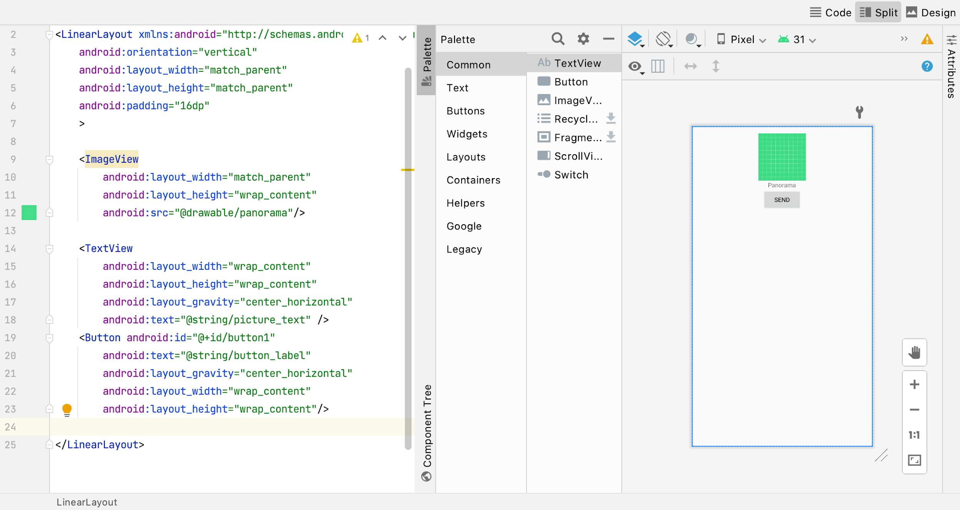
Create a view via XML
A powerful layout editor is available to make it easy to create the XML content

Slide 31
Create a view via XML
While the hierarchy is described via XML, customizations can be made via code
Each element of the display tree has to be identified
Each element has an attribute named id, which can be assigned a unique value using the syntax
android: id = "@+id/element_name"
The compiler automatically creates a constant named R.id.element_name, and associates a unique value to it
After loading the XML file, you can get the reference to each widget using the generic method
findViewById<T: View>(id: Int): T?

Slide 32
Create a view via XML
override fun onCreate(savedInstanceState: Bundle?) {
super.onCreate(savedInstanceState)
setContentView(R.layout.activity_main)
val button : Button = findViewById(R.id.button1)
button.setOnClickListener {
// … do something when button is pressed
}
}

Slide 33
Create a view via XML
Pros
Easy to maintain
You can use the visual editor provided in Android Studio
It supports string internationalization
Cons
It is necessary to uniquely identify elements in the view in order to access them in code, in order to customize their behavior
Ids must be kept in sync between the XML representation and the Kotlin code

Slide 34
Using the Jetpack Compose library
Modern approach to describe GUIs
Inspired from the javascript React library
Views are described as functions labelled with the @Composable annotation
Their body consist of invocations to other composable functions, leveraging on a concise and idiomatic use of the Kotlin programming language
The entire composition is hosted in a canvas where each single item is rendered

Slide 35
Using the Jetpack Compose library
@Composable
fun Panorama(name: String) {
Column(
Modifier.padding(16.dp),
horizontalAlignment = Alignment.CenterHorizontally,
) {
Image(
painter = painterResource(R.drawable.ic_launcher_background),
contentDescription = null,
modifier = Modifier.fillMaxSize(0.8f)
)
Text("$name!")
Button(onClick = { /* TODO */ }) {
Text("Send")
}
}
}

Slide 36
Using the Jetpack Compose library
Pros
One codebase consisting of concise and idiomatic Kotlin
Declarative
Compatible
Designed for and with Material Design
Fewer tools required
Cons
Requires programming skills
Designers find the layout editor more intuitive

Slide 37
Processes in Android
Differently from what happens in most other operating systems, process boundaries in Android look more "liquid"
The process that host an app is created and terminated at the system will, rather than at the user's one
Most of the times, closing an app does not terminate the corresponding process
Sometimes, a process is terminated even if the corresponding app has not been closed and it will be later recreated when the user starts interacting again with the app
Moreover, what is perceived as a single app, may actually be the composed of components belonging to different apps, hosted in their own process
The articulated nature of component life cycles makes it possible to create such kind of mix-ins, provided that they are correctly implemented

Slide 38
Saving the state of an activity
When the operating system needs to terminate the process that hosts an activity, it notifies it by invoking onSaveInstanceState(b: Bundle)
The method is usually overridden in order to save the activity state
In the Bundle object it is possible to save simple objects (integers, boolean, String) or objects that implement the Serializable or Parcelable interfaces
When the operating system will recreate the process, it will restore the content of the bundle and pass it to the methods onCreate(…) and onRestoreInstanceState(…)
This is overridden as well in order to restore the state
If the application terminates by calling the method finish(), nothing will be saved
Since this is interpreted as the user will to definitely terminate the process

Slide 39
Intents
If the application logic requires to create a new Android component (activity, service) or to notify a broadcast receiver, an android.content.Intent object is created
And delivered to the expected target via the intermediation of the operating system
Activities offer a set of dedicated methods, accepting Intent parameters, to carry out this task
startActivity(…), startService(…), sendBroadcast(…), …
Intents may be implicit or explicit
An implicit intent describes an intended action (dialing a number, sending an e-mail, …) leaving to the OS the responsibility to choose what component of what apps will be in charge of performing the requested task
An explicit intent indicates the specific component that must be activated

Slide 40
Implicit Intents
Indicate the action to be performed
Letting the operating system finding the component that is able to handle it
Defined in terms of
Action - an unique string taken from a predefined list or specified by the programmer
URI - a resource identifier whose schema can be used to identify possible recipients
Category - a string that provides additional details on the requested action
If an intent refers to one or more categories, only the components that declare to manage all the listed categories in the manifest file are considered

Slide 41
Implicit intents
When a well-known action must be executed by the default app in charge of it, an implicit intent is created
And delivered via method startActivity(…)
If necessary, extra data may be provided, storing them inside a Bundle
Since the OS is in charge of delivering the event possibly to a different process, only serializable or parcelizable data can be stored inside it
val action:String = Intent.ACTION_DIAL
val uri:URI = Uri.parse("tel:+390110905555")
val dialer = Intent(action, uri)
startActivity(dialer)

Slide 42
Explicit Intents
An explicit intent references the class of the component to be activated
As such, it does not need neither an action not a uri
But it is much more common to pass extra values which will be used to customize the behavior of the invoked component
val intent = Intent(this, SomeActivity::class.java);
intent.putExtra("someParameter", "foo")
intent.putExtra("somethingElse", 42 )
startActivity(intent);

Slide 43
Transitions between activities
When an activity starts another one, the latter is created and pushed on top of the activity stack
Its user interface will usually hide the previous one and the corresponding callback notifications will be issued
It the new activity is supplied by a different app, a new process will also be started
When the requested activity finishes, it will be popped from the stack, revealing the previous one that will simply be notified of being again resumed
Some variations on this basic pattern exist
The new activity might replace the former one in the activity stack
The new activity might provide some kind of result to the former one

Slide 44
Transitions between activities
Intent
Intent
startActivity()
onCreate()
Activity A
Android
OS
Activity B
1
2
3
same or different processes

Slide 45
Simple invocation
One
One
startActivity(…)
onPause()
Two
One
onCreate(...)
Two
setContentView(…)
Message loop
onStart()
onResume()
onStop()
finish()
onDestroy()
One
onRestart()

Slide 46
Activity replacement
One
One
startActivity(…)
finish()
onPause()
onStop()
Message loop
onDestroy()
Two
onCreate(...)
Two
setContentView(…)
onStart()

Slide 47
Requesting a value
An activity may start another one in order to collect some value from the user
When the second activity terminates, the value must be returned back to the one that invoked it
Since the second activity can potentially be invoked from many different invokers, hardwiring its name in the intent is not an option
The invoker must define a property of type ActivityResultLauncher<Intent> and initialize it with the following block of code:
private val launcher = registerForActivityResult(
ActivityResultContracts.StartActivityForResult()) { processResponse(it) }
private fun processResponse(res: ActivityResult) {
if (res.resultCode == RESULT_OK)
val data: Intent? = res.data // response intent
}

Slide 48
Requesting a value
One
One
launcher.launch(intent)
onPause()
Two
One
Two
onCreate()
Message loop
setContentView(…)
onStop()
setResult(…)
finish()
onDestroy()
One
onRestart()
processResponse(…)

Slide 49
Main activity
The activity to be launched at startup is defined in the AndroidManifest.xml file
…
<activity
android:name=".MyMainActivity"
android:label="@string/app_name">
<intent-filter>
<action
android:name="android.intent.action.MAIN" />
<category
android:name="android.intent.category.LAUNCHER" />
</intent-filter>
</activity>
…

Slide 50
Broadcasting Intents
An activity can broadcast an Intent object, using the method sendBroadcast(…)
It will be received by all applications that registered a listener via the registerReceiver(…) method of their context
Typical usage is for generating system wide notifications
private fun sendNotification(info:String) {
val intent = Intent()
intent.action = "com.example.Broadcast"
intent.putExtra("MyData", info)
intent.flags = Intent.FLAG_INCLUDE_STOPPED_PACKAGES
sendBroadcast(intent)﻿
}

Slide 51
Receiving broadcast Intents
Prior to version 8.0, a broadcast receiver had to be declared in the manifest file
It must extend the android.content.BroadcastReceiver class and implement the onReceive(…) method
On Android 8.0+ the receiver must be wired via code using the registerReceiver(…) method
When it is no more needed, it can be removed via unregisterReceiver(…)

Slide 52
Receiving broadcast Intents
class MyActivity: AppCompatActivity() {
var receiver: BroadcastReceiver? = null
override fun onCreate(b:Bundle?) {
super.onCreate(b)
setContentView(…)
val filter = IntentFilter()
filter.addAction("com.acme.Broadcast")
receiver = MyReceiver()
registerReceiver(receiver, filter)
}
override fun onDestroy() {
super.onDestroy()
unregisterReceiver(receiver)
}
}
class MyReceiver: BroadcastReceiver() {
override fun onReceive(
context: Context,
intent: Intent) {
Toast.makeText( context,
"Got a BroadcastIntent",
Toast.LENGTH_LONG ).show()
}
}﻿

Slide 53
Inheritance hierarchy
Activities, services and applications are modeled by the relative classes, that compose an inheritance hierarchy
They have a common root: the android.content.Context class
Context provides the functionality needed to access resources and application-specific classes and to interact with the operating system
Start other activities, send and receive intent, access the file system, ...
Each active component form its context
Its life cycle coincides with that of the component
There is also a global context, relative to the entire application
Accessible via the method getApplicationContext()

Slide 54
Context class hierarchy
abstract Context
BroadcastReceiver
getApplicationContext()
bindService(…)
unbindService(…)
startActivity(…)
sendBroadcast(…)
registerReceiver(…)
unregisterReceiver(…)
ContentProvider
ContextWrapper
ContextThemeWrapper
Service
Application
Activity

Slide 55
Differences in contexts
 | Application | Activity | Service | Content Provider | Broadcast Receiver
Show Dialog | No | Yes | No | No | No
Start Activity | No (*) | Yes | No (*) | No (*) | No (*)
Inflate Layout | No (**) | Yes | No (**) | No (**) | No (**)
Start Service | Yes | Yes | Yes | Yes | Yes
Bind Service | Yes | Yes | Yes | Yes | Yes
Send Broadcast | Yes | Yes | Yes | Yes | Yes
Register Receiver | Yes | Yes | Yes | Yes | Yes
Load Resources | Yes | Yes | Yes | Yes | Yes
(*): creates a new task; (**): No theme is applied

Slide 56
Context and resources
One of the main features offered by the context is the access to resources
Set of strings, images, xml files, ..., which are aggregated to the executable file in order to be uniformly and independently accessible from the installation folder
Each resource is identified by a unique number
Automatically generated at compile time and stored in a constant in the R class

Slide 57
Accessing resources and preferences
Resources stored in the application binary can be retrieved from a context using the getResources() method
The returned object offers, for each category of resources, a specific method via which the specific resource may be accessed
An application can persist and retrieve a set of relevant key/values pairs via the getSharedPreferences() method
The returned object offer methods to retrieve a value, given its key, as well as the edit() method that allow to modify and persist the pairs
val greeting = context.getResources().getString(R.string.hello);
val editor = context.getSharedPreferences("prefs", MODE_PRIVATE).edit()
editor.putInt("someData", 42).commit()

Slide 58
More features
The Context class also allows you to:
Getting assets included in the application
Request system services
Manage files, directories, and databases accessible only to the current application
Check and activate application authorizations
…

